Slide 1
React
Present by
Suresh kumar

Slide 2
Index
JS Frameworks
React Prerequisite
JSX
Create React JS
React Components
React Hooks

Slide 3
React
React JS coding Hierarchy is Components → Services → Route
Component is → tab/button/page
Services is → like event,Services based on request and response rendered on the result
Route is → like Navigation/path

Slide 4
Create React App
You’ll need to have Node >= 14.0.0 and npm >= 5.6 on your machine.to check versions node -v and npm -v
To create a project, run:
npx create-react-app AppName
cd AppName
npm start
Explain Folder structure

Slide 5
Functional Component
These are simply JavaScript functions. We can create a functional component to React by writing a JavaScript function
Hooks Concepts
import React from 'react'
function FunComp() {
return (
<div>FunComp</div>
)
}
export default FunComp

Slide 6
React Hooks
Hooks were added to React in Version 16.8
Hooks allow function components to have access to state and other React Feature
You must import Hooks from react
Hooks can only be called inside React functional component
Hooks can only be called at the top level of the component
Mostly used Hooks are useState , useEffect, useRef, useContext

Slide 7
useState Hooks
Syntax: The first element is the initial state, and the second one is a function used to update the state (variable).
const [state, setState] = useState(initialState)
FormEx:
(…data) indicates every data.
[e.target.name]:[e.target.value] indicates a particular username(name) = that particular age(value).

Slide 8
useState Hooks
import React, { useState } from 'react'
function UseStateEx() {
const[count,setCount]=useState(0);
const[name,setName]=useState('')
const handleClick =()=>{
setCount(count+1)
}
const nameChange=(e)=>{
setName(e.target.value)
}
return (
<div>
<h1> counter : {count}</h1>
<h2> name : {name}</h2>
<label>Name</label> <br/>
<input type='text' value={name} onChange={nameChange} />
<button onClick={handleClick} > increase </button>
</div>
)
}
export default UseStateEx

Slide 9
useState Example:
import React,{useState} from "react";
function CompA(params){
const [color,setColor]= useState('Red')
console.log(params.props)
return(
<div>
<h1>My favorite color is {color}!</h1>
<button type="button" onClick={() => setColor("blue")}>Blue</button>
<button type="button" onClick={() => setColor("red")}>Red</button>
<button type="button" onClick={() => setColor("pink")}>Pink</button>
<button type="button"onClick={() => setColor("green")}>Green</button>
</div>
)
}
export default CompA;

Slide 10
useEffect Hooks
The react useEffect Hook allows us to perform side effects in your components.Side effects are not predictable because they are actions which are performed with the outside of our React components to do something
Some examples of side effects are : Making a request to an API for data from a backend server, Using unpredictable timing functions like setTimeout or setInterval
useEffect accepts two arguments function and dependency, the second argument is optional.
The React hook useEffect helps in adding componentDidUpdate and componentDidMount combined lifecycle in React functional component.

Slide 11
useEffect Example:
import React ,{useState,useEffect} from 'react'
function Timer() {
const[count,setCount]=useState(0);
useEffect(()=>{
setTimeout(()=>{
setCount((count)=>count+1)
},1000)
})
return (
<>
<h1>I've rendered {count} times!</h1>;
</>
)}
export default Timer

Slide 12
useEffect Render -dependency
No dependency Passed :
useEffect (()=>{
//Runs on every render
})
An Empty array :
useEffect (()=>{
//Runs only on the first render
},[])
Props or State values :
useEffect (()=>{
//Runs on the first render && any time dependency value changes
},[state])

Slide 13
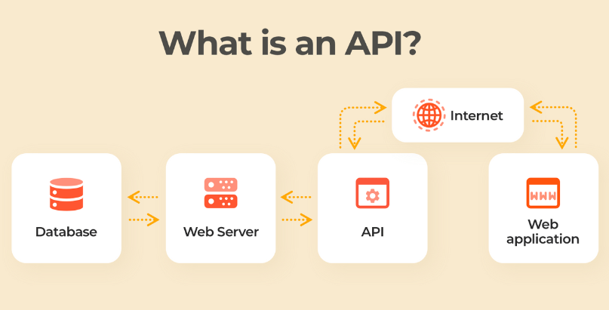
API Calls
The API stands for Application Programming Interface.
It serves as a data transmitter between different piece of software
Here are the possible ways to make an API call:XMLHttpRequest ,fetch,Axios,jQuery

Slide 14
API Methods
Get → Receive information as It read-only access to a resource.
POST → It is used to create or update a new resource.
PUT → It is used to update or replace an existing resource or create a new resource.
DELETE → It is used to remove a resource.
Syntex : (need to install package)
axios.get(url)
.then((res) )
.catch((error))

Slide 15
Axios Example:
import { useEffect, useState } from "react"
import axios from 'axios';
function ApiCalls(){
const[fetchData,setFetchData]=useState([])
useEffect(()=>{
callAPI()
},[] )
function callAPI (){
axios.get('https://jsonplaceholder.typicode.com/users')
.then(
(res) => {
console.log("api res", res.data);
setFetchData(res.data)
})

Slide 16
Axios Example:
.catch((error) => {
console.log('res Account error', error);
})
}
return(
<div>{
fetchData && fetchData.map((i)=> <div>{i.username} </div>)}
</div>
)
}
export default ApiCalls

Slide 17
Router
React Router is a standard library for routing in React.
It enables the navigation among views of various components (navigate from one page to another page ) in a React Application, allows changing the browser URL, and keeps the UI in sync with the URL.
However, the core React library doesn’t come with a page routing mechanism by default. For this, we need to make use of a library named React Router.
npm i react-router-dom

Slide 18
Thank You!!

